Slide 1
TEAM MEMBERS:
Manichand_2010030455
Harsha_2010030173
PRAKASH _2010030533
Dileep _2010030416
TITLE: Named entity recognition (NER)

Slide 2
INTRODUCTION :-
Named Entity Recognition (NER) is a natural language processing task that attempts to find named entities (persons, locations, organizations, etc.) within a text. Since the tag of one word depends on neighboring words (and their tags), the problem is modeled as a sequence labeling task, wherein a sentence is considered as an input, and the goal is to produce the tags of all words jointly, so as to maximize accuracy.

Slide 3
FLOW DIAGRAM

Slide 4
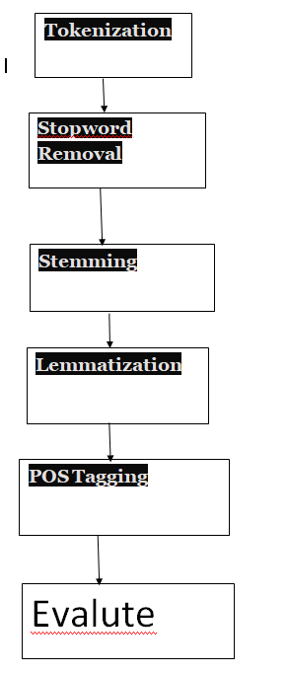
PREPROCESSING STEPS :-

Slide 5
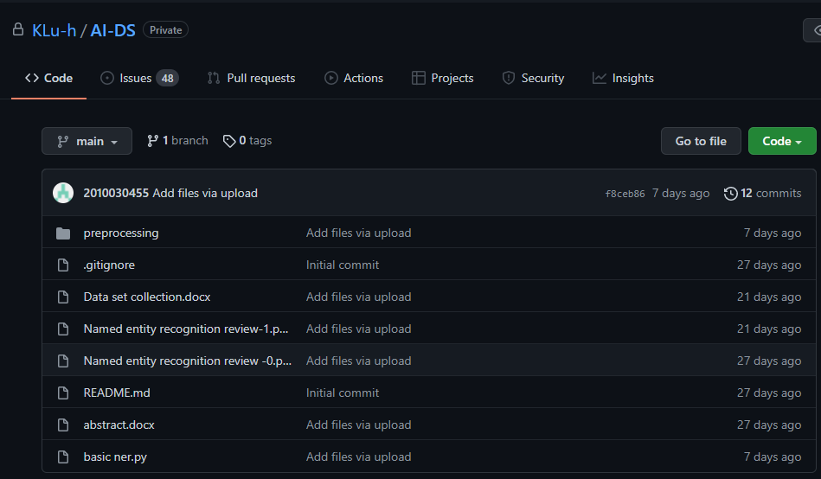
GITHUB COMMITS:-

Slide 6
PRE-PROCESSING & TECHNIQUES :-
Tokenization:-
Tokenization is the process of removing sensitive data and placing unique symbols of identification in its place to retain all the essential information.
CODE:-
import nltk
sentence_data = "The First sentence is about Python. The Second: about Django. You can learn Python,Django and Data Ananlysis here. "
nltk_tokens = nltk.sent_tokenize(sentence_data)
print (nltk_tokens)

Slide 7
PRE-PROCESSING & TECHNIQUES :-
Stop-word Removal:-
Stop — words are natural language words which have very little meaning such as ‘a’, ‘an’, ‘and’, ‘or’, ‘the’.
⁃ These words take up space in a database and increase the processing time.
⁃ They can be removed by storing an of stop-words.
⁃ Stop-words are filtered out before processing of natural language data as they don’t reveal much information.
Code:-
import nltk
from nltk.corpus import stopwords
print(stopwords.words('english'))

Slide 8
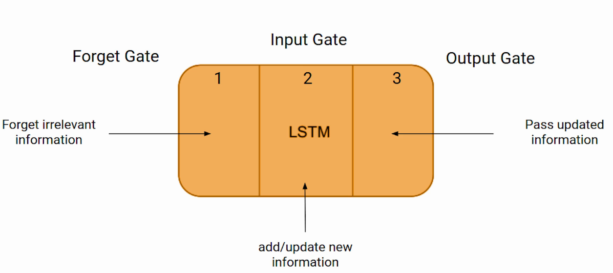
MODEL :-

Slide 9
References:-
BERT:
Lee, Jinhyuk, Wonjin Yoon, Sungdong Kim, Donghyeon Kim, Sunkyu Kim, Chan Ho So, and Jaewoo Kang. "BioBERT: a pre-trained biomedical language representation model for biomedical text mining." Bioinformatics 36, no. 4 (2020): 1234-1240.
Transformer:-
Xu, Lu, Zhanming Jie, Wei Lu, and Lidong Bing. "Better Feature Integration for Named Entity Recognition." arXiv preprint arXiv:2104.05316 (2021).
knowledge distillation:-
Zhou, Wenxuan, and Muhao Chen. "Learning from Noisy Labels for Entity-Centric Information Extraction." arXiv preprint arXiv:2104.08656 (2021).

Slide 10
MLMET:-
Dai, Hongliang, Yangqiu Song, and Haixun Wang. "Ultra-Fine Entity Typing with Weak Supervision from a Masked Language Model." arXiv preprint arXiv:2106.04098 (2021).
GCN :-
Seti, Xieraili, Aishan Wumaier, Turgen Yibulayin, Diliyaer Paerhati, Lulu Wang, and Alimu Saimaiti. "Named-entity recognition in sports field based on a character-level graph convolutional network." Information 11, no. 1 (2020): 30.
Bender:-
Li, Jing, Aixin Sun, Jianglei Han, and Chenliang Li. "A survey on deep learning for named entity recognition." IEEE Transactions on Knowledge and Data Engineering (2020).
References

Slide 11
Bi-LSTM:-
Jang, Beakcheol, Myeonghwi Kim, Gaspard Harerimana, Sang-ug Kang, and Jong Wook Kim. "Bi-LSTM model to increase accuracy in text classification: Combining Word2vec CNN and attention mechanism." Applied Sciences 10, no. 17 (2020): 5841.
CNN:-
Zhu, Qile, Xiaolin Li, Ana Conesa, and Cécile Pereira. "GRAM-CNN: a deep learning approach with local context for named entity recognition in biomedical text." Bioinformatics 34, no. 9 (2018): 1547-1554.
LSTM:-
Cho, Minsoo, Jihwan Ha, Chihyun Park, and Sanghyun Park. "Combinatorial feature embedding based on CNN and LSTM for biomedical named entity recognition." Journal of biomedical informatics 103 (2020): 103381.
References

Slide 12

THANK YOU

